Slide 1


Amazon - Babel + App Training

Slide 2

Babel + App
Babel App is technology tool that Amazon provides trainers to break down language barriers Thanks to this App, your training session will be instantly translate in more than 25 languages and drivers will able to read/listen the class in their own language simultaneously. Amazon Drivers use this app during their morning session.

Slide 3

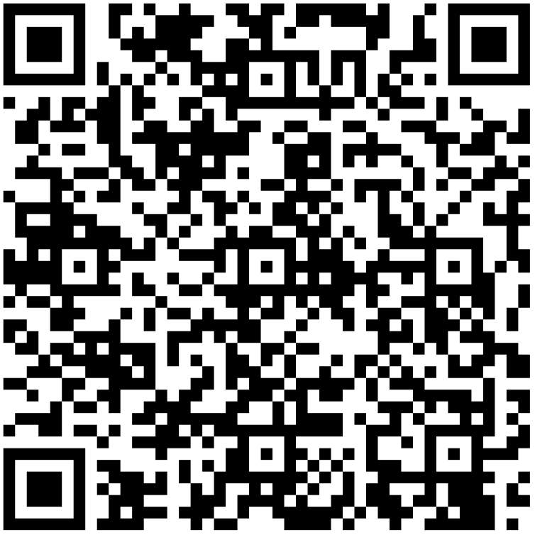
Download App - Android
Scan the QR code and download the app from your play store.

Slide 4
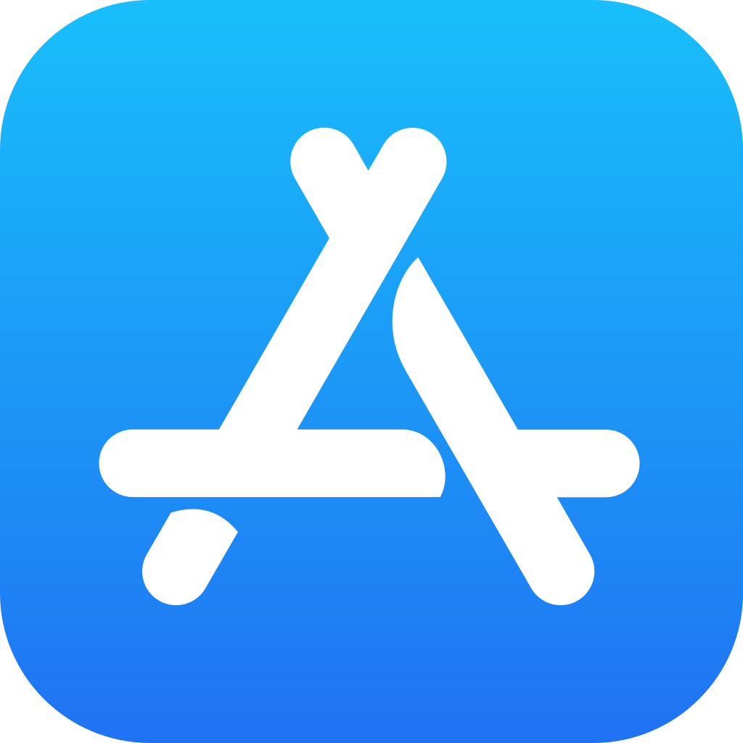

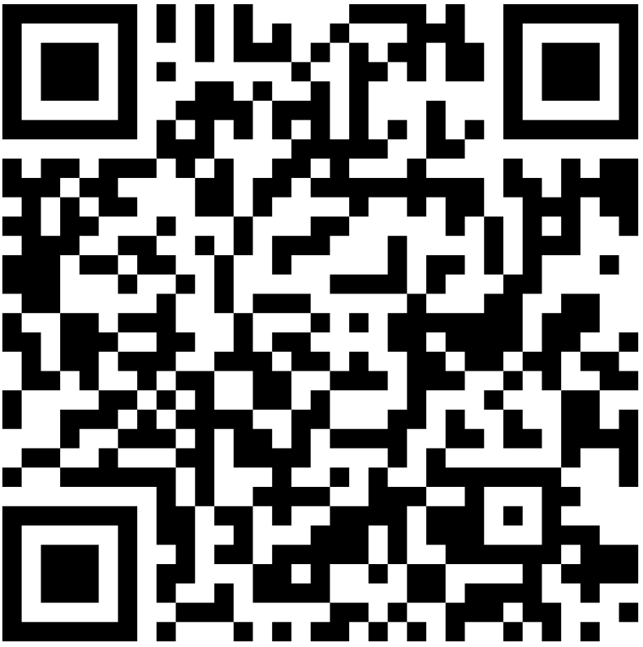
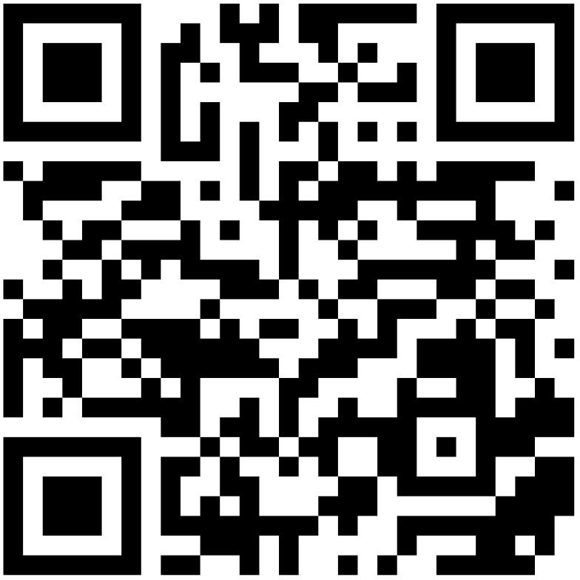
Download App - iOS Apple
Scan the 1st QR code, download the app from the apple store and close it.
Scan the 2nd QR code and download babel translator
1.
2.

Slide 5
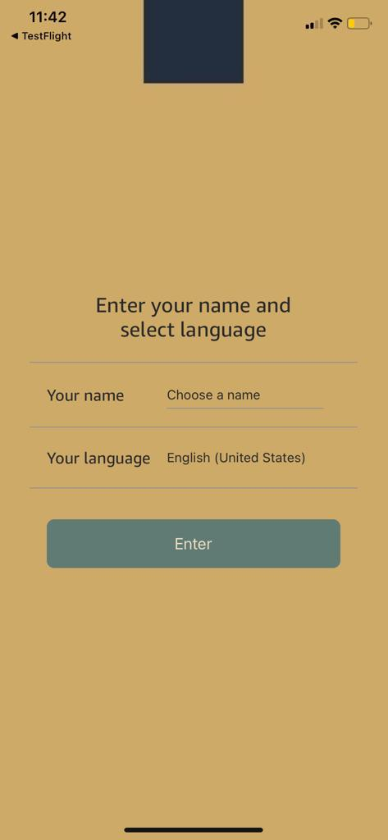
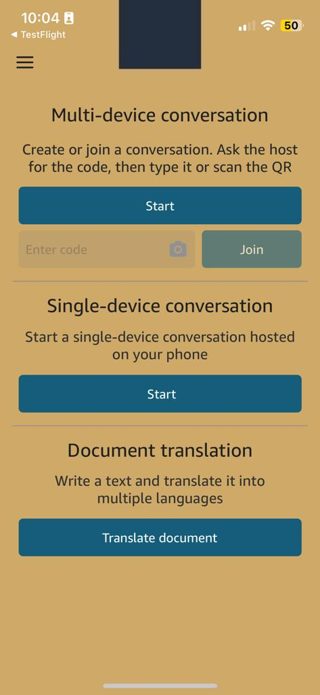
Registration
Open Babbel App
Enter your Name
Choose the app language
Click “Enter”
You will be redirected to the home-page
Registration page
Home-page

Slide 6
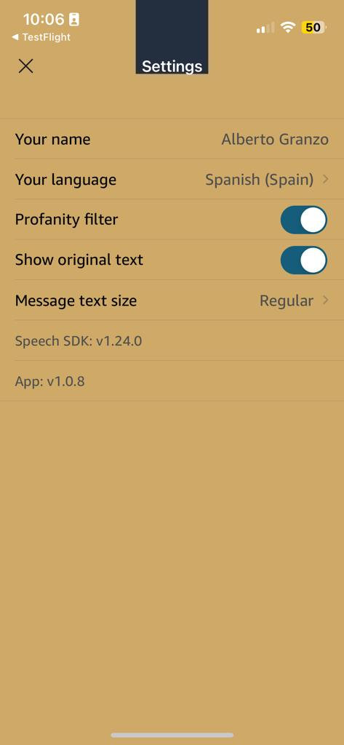
Babel settings
From home page, click on the tree lines up-left to open setting page.
Your name: Edit your registration name
Your language: change the language you want to translate or speak.
Profanity filter: Encrypt vulgar words
Show Original text: enable to see translations and original language text
Message text size
Home-page
Settings

Slide 7
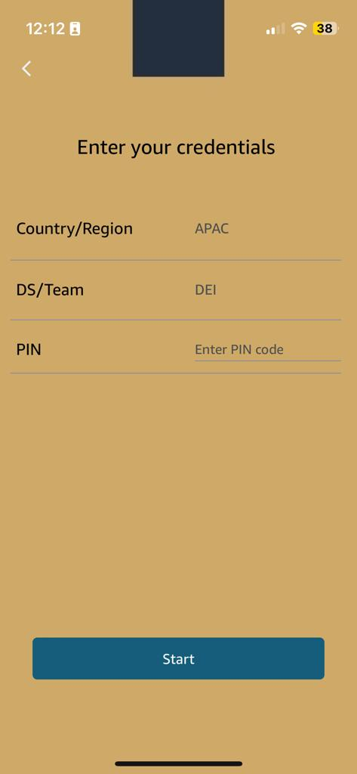
Multi-device conversation Trainers only
Trainers can create a session clicking “Start” under Multi-device conversation
Country/Region: choose the training’s country
DS/Team: Choose the AMAZON station of the training - ADD COUNTRY DS CODE
PIN: TRAINER (all caps letters)
Click on “Start”
Once you clicked start, the session will bec created as well as a code for each driver to join the session
Home-page
Multi-device conv activation

Slide 8
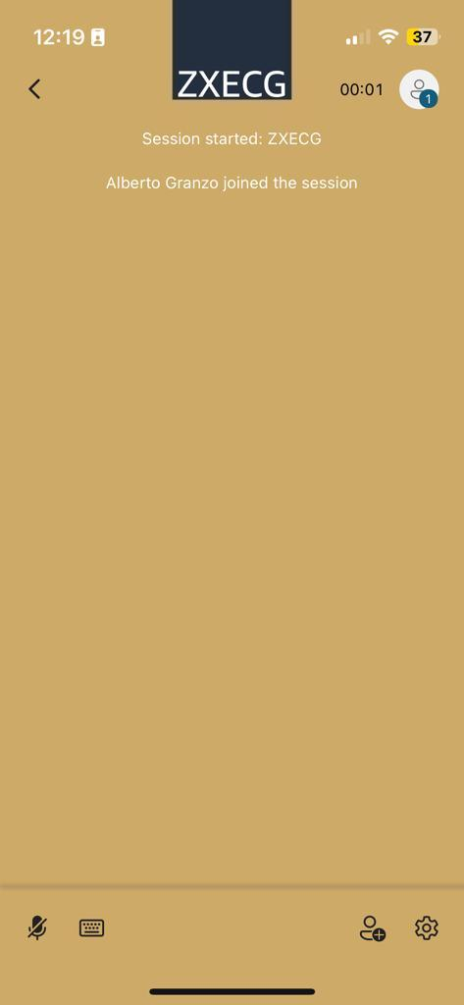
Multi-device session CODE
Once the session is started, in your screen you will see the session joining code each driver needs to enter the session EX: ZWECG
Multi-device session

Slide 9
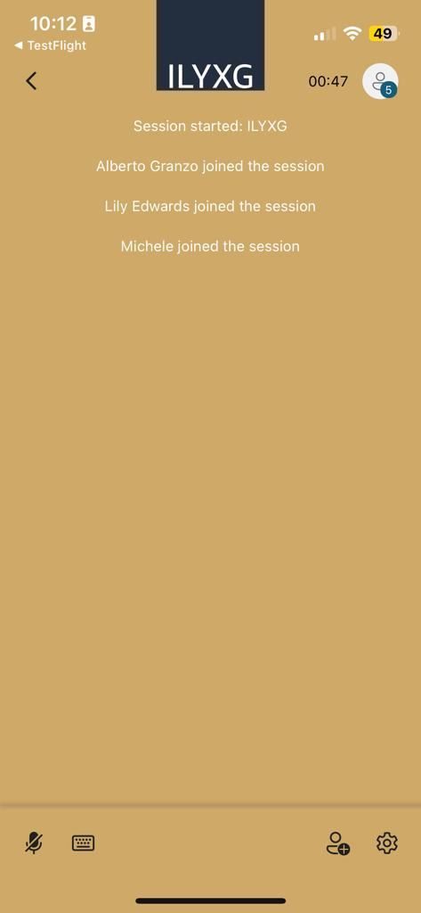
Multi-device conversation DRIVERS
Provide the miltiu-device session code to each drivers
Driver enter the code (ex ILYXG) and click join to enter the sessions.
As drivers are joining, you will see thier registration name on the conversation a
Once you clicked start, the session will bec created as well as a code for each driver to join the session
Home-page
Multi-device conv conversation

Slide 10
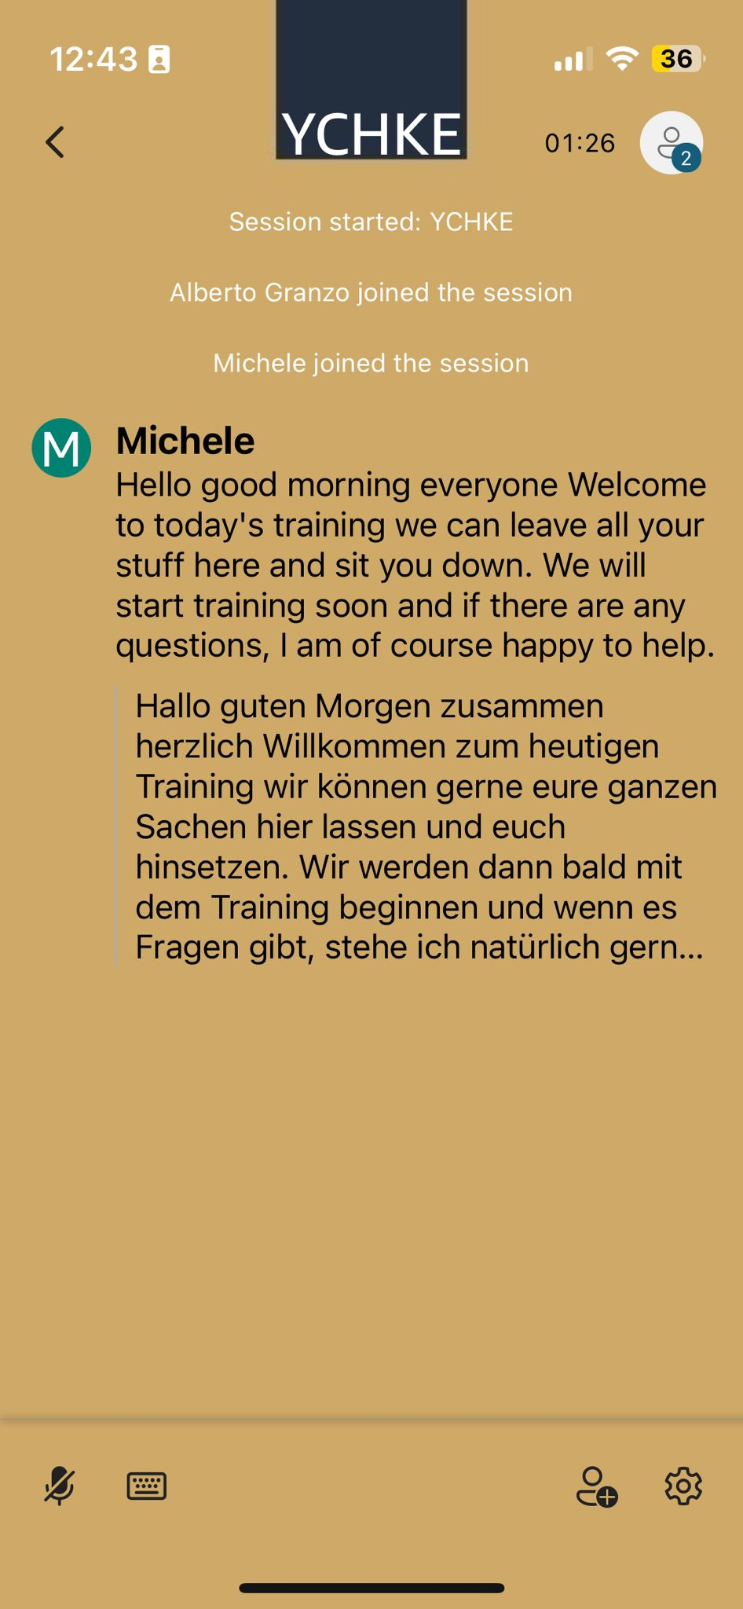


How to use babel
Once the session is started and drivers are connected:
Click on the microphone on the bottom-left and start speaking
Click again when you are done so other participants can speak
Click on the keyboard to type sentences and be translate
Click on the Add member icon on the bottom-down to generate a QR code for driver to join the session
Click the gear to open settings - activate speech mode
Multi-device conv activation

Slide 11
Babel Tips
How to talk
While Talking
For Drivers
Don’t worry about how you talk. Follow your speech and make it clean and clear. Talking fast is perfect!!
Is not necessary to click and unclick the microphone after every sentence. Leave it on until you finish your or any driver have questions. Translation will be done simultaneously
Drivers can abilitate the speech mode in the session settings. This allows them to hear your voice translated and easily follow the class headphones are much recommended

